Slide 1

Intro to simple mathematic modeling for data scientist
Shuai Wang

Slide 2

Agenda
Introduction of math modeling
How to use python and R package for modeling
Examples

Slide 3
Intro of Operations Research field
OR involves a variety of techniques that aim to create math models that describe real or theoretical systems
Solve the models for optimal solutions to improve systems efficiency and support decision-making
It is a scientific approach to making best decisions
The model is usually under conditions requires the allocation of limited resources(time, budget, etc.)
Notes:
Filed of OR

Slide 4
Math modeling
OR requires the use of models, which have mathematical representations of the actual system.
Modeling:
Describing a system at a high level of abstraction (or simplification), which ignores irrelevant details and only represent the relevant details.

Slide 5
Models Classification:
 | Strategy Evaluation | Strategy Generation
Certainty | Deterministic Simulation Econometric Models Systems Simulation of Simultaneous Equations Input-Output Models | Linear Programming Network Models Integer and MILP Non-Linear Programming Control Theory
Uncertainty | Monte-Carlo Simulation Econometric Models Stochastic Processes Queuing Theory Reliability Theory | Decision Theory Dynamic Programming Inventory Theory Stochastic Programming Stochastic Control Theory
Source by Bradley, Hax, and Magnanti (Addison-Wesley, 1977)

Slide 6
Categories of Math Models
Model Category | Functional Form f(.) | Independent Variables | OR/MS Techniques
Descriptive What has happened? | Known, well- defined | Unknown or uncertain | Simulation, PERT, Queueing Theory, Inventory Models
Predictive What could happen? | Unknown, ill-defined | Known or Under decision maker’s control | Regression Analysis, Time Series Analysis, Discriminant Analysis
Prescriptive What should we do? | Known, well-defined | Known or Under decision maker’s control | Optimization (IP, MILP, EOQ, NLP…)
Source by Bradley, Hax, and Magnanti (Addison-Wesley, 1977)
Notes:
Concrete Example, slide5,

Slide 7
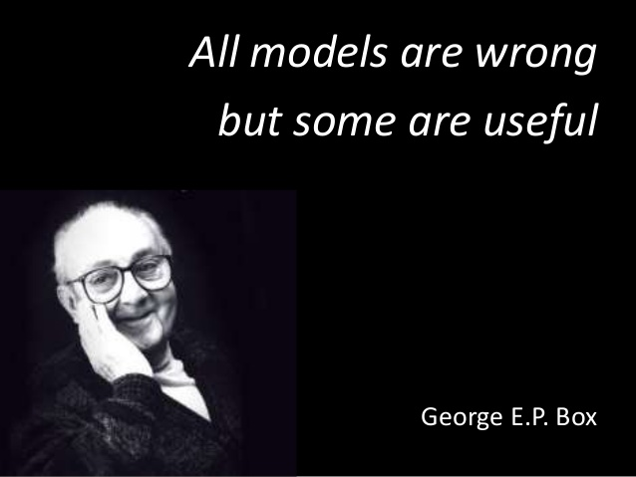
Level of abstraction
“All models are wrong, but some are useful”
– George Box (1919-2013)

Slide 8
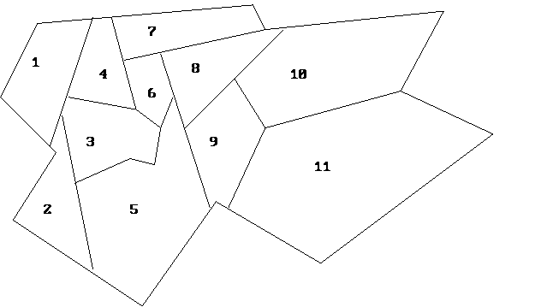
Hello World
A fire station can be placed in any neighborhood.
The objective is to minimize the number of fire stations used.
A city is reviewing the location of its fire stations. The city is made up of a number of neighborhoods:
How to make decisions?
What are the rules?
Simplified rule: It is able to handle the fires for both its
neighborhood and any adjacent neighborhood.
Notes:
City planner

Slide 9
Abstraction
What are the decisions? How to represent?
What’s the goal?

Slide 10

Abstraction
Create one variable Xi for each city i.
This variable will be 1 if we place a station in the city, and will be 0 otherwise.

Slide 11
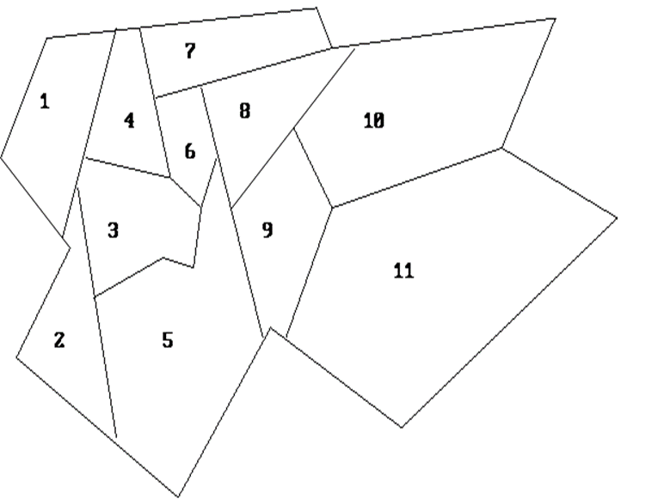
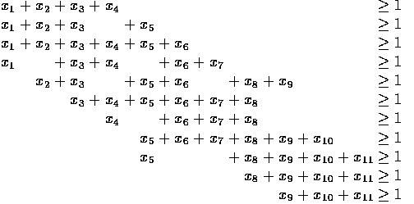
Abstraction
What are the constraints?
It is able to handle the fires for both its neighborhood and any adjacent neighborhood.

Slide 12
Abstraction
What’s the objective?
To minimize the number of fire stations used.

Slide 13
Level of abstraction
Real World
Simplified World
Model
1. Shape
2. Boundary
3. Certainty
4. Dynamic
Notes:
The real world: the shape is irregular; the boundary is blurry; uncertainties; dynamic;
After making assumptions, we reduce world into this simplified world.: the shape is regular; boundaries are clear and crisp; every parameter is certain and does not change over time;
Model: built based on the simplified world. The original intention was to use the model to represent the real world, the model capture a subset of the characteristics of the real world, so the model is wrong.
However, if we only care about a specific aspect of the real world, and the world has contained the most important information of this aspect, and the parameters do not change much if we are dealing with the short-term characteristic of the world, then we can still use the model to approximate the real world and make useful decisions , the model is useful.

Slide 14
Course Agenda
Successful Applications of Operations Research Models
Optimization modeling
Definitions and Concepts
Algebraic Representation & Model Formulations
Workshop
Software (R and Python packages)
Optimizer
Examples

Slide 15
Applications of operations research models
Transportation
Bike Sharing:
City Bikes. Location selection. A 10% increase in bike availability would increase ridership by more than 12%.
School Bus: Routing and bell time optimization.
Boston saved $5 million in yearly savings (maintaining service quality despite a 50-bus fleet reduction)
Sports
Game Scheduling. NFL. The allocation of home/away game.
Four people have 10 weeks to schedule 256 games over the course of a 17-week season.
Public Policy
Law Enforcement: The Inmate Assignment and Scheduling Problem.
What once took seven employees nearly a week to accomplish can now be completed in less than 10 minutes at an expected savings of nearly $3 million.
Education
Scholarship: Merit-based scholarship allocation to maximize enrollment.
Increase 11% and 13% yearly enrollment under same budget.
Course/Exam: Scheduling system to allocate classroom and time for course and exam.
Bill Gate’s Netflix documentary (episode 2)
Retail
Inventory: Kroger. Simulation-Optimization to Improve Pharmacy Inventory Management.
reduction in inventory by more than $120 million, and a reduction in labor cost equivalent to $10 million per year
Notes:
https://pubsonline.informs.org/doi/abs/10.1287/mnsc.2019.3407
https://www.gurobi.com/wp-content/uploads/2018/12/NFL-CASE-STUDY-LETTER-ENG.pdf
https://www.pnas.org/content/116/13/5943
http://www.optimization-online.org/DB_FILE/2017/10/6308.pdf
https://www.pathlms.com/informs/events/260/thumbnail_video_presentations/6881

Slide 16
Algebraic modeling languages
Algebraic modeling languages (AML) are high-level computer programming languages for describing and solving high complexity problems for large scale mathematical computation (i.e. large scale optimization type problems).
One particular advantage of some algebraic modeling languages like AIMMS, AMPL, GAMS, IBM OPL (Commercial); Minizinc, JuMP, Pyomo, PuLP, OMPR (Open Source) is the similarity of their syntax to the mathematical notation of optimization problems.
This allows for a very concise and readable definition of problems in the domain of optimization, which is supported by certain language elements like sets, indices, algebraic expressions, powerful sparse index and data handling variables, constraints with arbitrary names
Source: Wikipedia contributors. (2018, May 27). Algebraic modeling language. In Wikipedia, The Free Encyclopedia. from https://en.wikipedia.org/w/index.php?title=Algebraic_modeling_language&oldid=843179612

Slide 17
Algebraic modeling languages
AML does not solve optimization problems directly.
Instead, it calls appropriate external algorithms to obtain a solution. These algorithms are called optimizer/solver and can handle certain kind of mathematical problems like:
linear problems
integer problems
(mixed integer) quadratic problems
mixed complementarity problems
mathematical programs with equilibrium constraints
constrained nonlinear systems
general nonlinear problems
non-linear programs with discontinuous derivatives
nonlinear integer problems
global optimization problems
stochastic optimization problems
Source: Wikipedia contributors. (2018, May 27). Algebraic modeling language. In Wikipedia, The Free Encyclopedia. from https://en.wikipedia.org/w/index.php?title=Algebraic_modeling_language&oldid=843179612

Slide 18
Algebraic modeling languages -- Solver
Popular solver for linear and integer optimization problems:
Commercial:
CPLEX
Gurobi
FICO Xpress
Open Source:
SCIP (commercial use restriction)
GLPK
CBC
SYMPHONY

Slide 19

Optimization modeling
An optimization model seeks to find values of decisions variables that optimize (maximize or minimize) one or more objective functions among the set of all values for the decision variables that satisfy the given constraints.
Decision variables
Controllable variables influencing the performance of the system.
Objective function(s)
A function we wish to maximize or minimize (reflects the relation between the decision variables and goal we want to achieve)
Single objective or multiple objectives
Constraints
A set of restrictions of decision variables.
Notes:
Example, write code, seprate the slides to 3 parts.

Slide 20
Using R (OMPR,ROI, ompr.roi, ROI.plugin.glpk )
library(dplyr)
library(ROI)
library(ROI.plugin.glpk)
library(ompr)
library(ompr.roi)
result <- MIPModel() %>%
add_variable(x, type = "continuous",) %>%
add_variable(y, type = "continuous", lb = 0) %>%
set_bounds(x, lb = 0) %>%
set_objective(2*x +3*y, "min") %>%
add_constraint(3*x + 4*y >= 1) %>%
solve_model(with_ROI(solver = "glpk"))
get_solution(result, x)
get_solution(result, y)
Variables:
X : continuous, [0, +inf)
Y : continuous, [0, +inf)
Constraint:
3X + 4Y > 1
Objective:
Minimize 2X+3Y

Slide 21
Use python (Pyomo)
Variables:
X : continuous, [0, +inf)
Y : continuous, [0, +inf)
Constraint:
3X + 4Y >= 1
Objective:
Minimize 2X+3Y
from pyomo.environ import *
model = ConcreteModel()
model.x = Var(domain=NonNegativeReals)
model.y = Var( domain=NonNegativeReals)
model.Constraint1 = Constraint(expr = 3*model.x + 4*model.y >= 1)
model.OBJ = Objective(expr = 2* model.x + 3*model.y)
solver=SolverFactory("glpk")
solver.solve(model)

Slide 22
Reference
Python: https://pyomo.readthedocs.io/en/stable/index.html
R: https://dirkschumacher.github.io/ompr/index.html

Slide 23
Knapsack problem

